Slide 1
PREPARATION OF WORK AND FINANCIAL PLAN (WFP) FOR FY 2021
October 7, 2020
School Division of Camarines Sur
San Jose, Pili, Camarines Sur

Slide 2
Presentation Outline
1. Introduction
2. National Expenditure Program
3.The Work and Financial Plan
4.Hierarchy of Objectives
5.Elements of the Work and Financial Plan
6.Alignment of Elements
7.Sample Practices
Notes:
this is the outline of my presentation

Slide 3
Introduction
Notes:
So lets start from the simple introduction

Slide 4
Types of Plans in DepEd
Type of Plan | Description | Document
Strategic Plan | Long-term plan for a desired future based on a thorough situational analysis, provides context for other plans | DEDP / SIP
Investment Plan | Resources needed for the strategic interventions and major programs | Investment Plan
Program Plan | Technical plan on the implementation details of the program including roles, beneficiaries, financial breakdowns, etc. | Program Profile
Operational Plan | Specific plan detailing the outputs, activities, resources, and schedule for the given period | WFP PPMP / APP
Plan Adjustment | Contingencies formulated after PIR to adjust the plans in order to keep implementation on track | Catch-Up Plan
Type of Plan
Description
Document

Slide 5
Budget – A table/schedule of expenditures, based on either obligations or cash concepts and the corresponding sources of financing, either from revenues, borrowings or cash balance drawdown.
An estimate of income and expenditure for a set period of time.

Slide 6
Public Financial Management - The Public Financial Management (PFM) Reform Program aims to improve efficiency, accountability and transparency in public fund use in order to ensure the direct, immediate, substantial and economical delivery of public services especially to the poor.

Slide 7
Public Financial Management Objectives
1.Fiscal Discipline - Spending w/in Means
2.Allocative Efficiency - Spending on the right priorities
3.Operational Efficiency - Spending w/ maximum results

Slide 8
Guidelines BEDs Preparation
•Government entities receiving budgetary support from the National Government annually submit their respective Budget Execution Documents(BEDs).
•BEDs are formulated based on the NEP for the budget year, contain the agency target plans, spending schedules, and physical targets.

Slide 9
Guidelines BEDs Preparation
•BEDs serve as bases for the determination of the national government disbursement programs.
•Obligations and implementations of programs, activities, and projects is limited to just one year under the ACBA.

Slide 10
Guidelines BEDs Preparation
Purposes:
1.To align the BEDs with the information presented and being required for the (BFARs);
2.To require agencies to furnish the DBM copies of the procurement documents being submitted to the (GPPB), and the DBM (PS), to ensure consistency of the information reflected in the BEDs with the procurement schedules/specifications;
3.To reiterate the submission of the BEDs prescribed under DBM Circulars & facilitate encoding in the URS.

Slide 11
National Expenditure Program

Slide 12
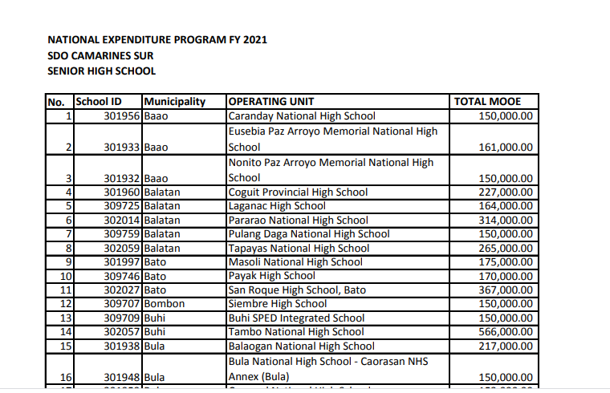
National Expenditure Program
Notes:
Like with the previous year, our basis for preparing our WFP is the NEP. Lahat na po ba alam kong magkano ang budget allocation nyo this year, kumusta tumaas po ba or the same lang po last year? and Kumusta po ang utilization natin ng ating MOOE, kya po ba nting maka 100% utilization this year? Kunin mo ang percentage ng increase

Slide 13
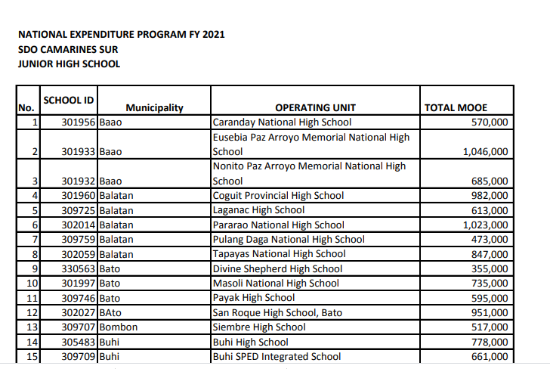
National Expenditure Program

Slide 14
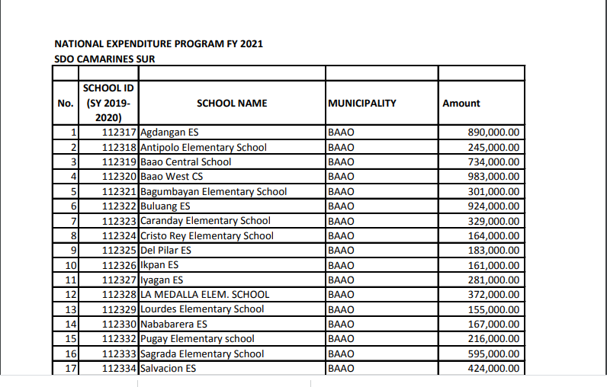
National Expenditure Program

Slide 15
Basics of the WFP
Notes:
Lets go to the WFP

Slide 16
What is the WFP?
•The Work and Financial Plan (WFP) is a Budget Execution Document (BED) which summarizes how the budget of an office is programmed for the whole fiscal year.
•The WFP Is composed of three (3) separate but synchronized parts:
•Physical plan
•Monthly obligation plan
•Monthly disbursement plan

Slide 17
Parts of the WFP
•The PHYSICAL PLAN (BED No. 2) contains the performance targets of the unit’s key or major programs and projects.
•The MONTHLY OBLIGATION PROGRAM (Financial Plan or BED No. 1) reflects the cost needed to conduct the activity considering the budget ceiling set by the management and/or the approved budget as reflected in the GAA.
•The MONTHLY DISBURSEMENT PROGRAM (BED No. 3) shows the monthly disbursement requirements of the office which is the basis for issuance of NCA by the DBM, and other disbursement authorities. In plotting the amount, consider the timing of payments to be made. (e.g., Tax remittance advice, non-cash availment authority, cash disbursement ceiling).

Slide 18
WFP Highlights
The WFP answers the following:
•What are the office’s/schoolsprograms?
•What are the outputs of each program?
•What activities will be conducted to produce the outputs?
•When will the activities be conducted?
•How much will each activity cost?
•When will the amount be obligated?
•When will the amount be disbursed?

Slide 19
Functions of the WFP
The WFP is a:
•Documentation of the office’s/schools annual plan
•Tool for monitoring & evaluation
•Physical & financial targets vis-à-vis accomplishments
•RMEA, DMEA & SMEA
The WFP ensures that all activities:
•Are aligned to a higher level objective
•Have a ready budget
•Are scheduled properly
Notes:
Regional Monitoring, Evaluation & Adjustment, DMEA & SMEA

Slide 20
What do we consider in preparing the Work and Financial Plan?

Slide 21
Preparing the Annual Plans

Slide 22
Hierarchy of Objectives

Slide 24
Hierarchy of Objectives

Slide 25
Hierarchy of Objectives

Slide 26
Elements of the Work and Financial Plan

Slide 27
Elements of the WFP

Slide 28
Output
•An object produced as a result of activities completed
•Must be quantifiable, tangible, and a product of conducted activities
Examples:
Teachers trained on Gender and Development (GAD)
Learning materials printed

Slide 29
Activity
•A task or set of tasks executed to produce a deliverable, given the needed inputs
•Smallest unit of work identified in the WFP
Examples:
•Conduct of training/seminar on teachers capacity building
•Conduct of training/seminar on Gender & Development Program
•Procurement of Supplies & Materials for Learning Modules.

Slide 30
Indicator
•A tool that provides the status or condition of something in particular
•Must be quantifiable and appropriate to track progress of the activity / output
Examples:
No. of training conducted for Capacity Building
No. of procurement conducted for LMs
No. of payment made (e.g Electricity Bills & Water Bills)
Notes:
This reflects the unit of measure for a particular output and/or output milestone and must be tangible

Slide 31
Cost
•Financial requirements of an activity
•Expressed both in terms of obligations and disbursements
•Breakdown of cost elaborated through the expenditure matrix
Examples:
Php 120,000.00 for cash advance
Php 890,000.00 for direct payment

Slide 32
Schedule
•Duration and frequency of an activity
•Expressed monthly in the WFP
Examples:
•Office assessment/evaluation conducted last month of the year (December)
•Cash Advances either monthly, quarterly or every other month.
•Obligation in June but disbursement in august (applicable for SDO & OUs)

Slide 33
Alignment of Elements

Slide 34
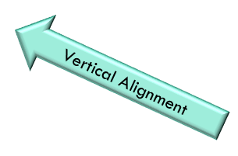
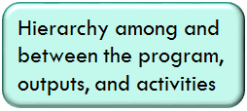
Basic Alignment Concepts
Program | Output | Activity | Indicator
Program A
 | Output X |  | No. of Outputs Produced
 |  | Activity 1 | No. of Activities Conducted
 |  | Activity 2 | No. of Activities Conducted
Program B
 | Output Y |  | No. of Outputs Produced
 |  | Activity 3 | No. of Activities Conducted

Slide 35
Sample 1
Program | Output | Activity | Indicator
School-Based Management
 | Updated Policy on SBM Framework |  | No. of Updated Policies on SBM Framework Developed
 |  | Conduct of Consultation Workshops | No. of Consultation Workshops Conducted
 |  | Conduct of Policy Writeshop on SBM Framework | No. of Policy Writeshops on SBM Framework Conducted
 |  | Conduct of Validation Workshop on Draft SBM Framework Policy | No. of Validation Workshops on Draft SBM Framework Policy Conducted
Program
Output
Activity
Indicator

Slide 36
Sample 2
Program | Ouput | Activity | Indicator
Preventive Drug Education
 | Teachers Trained on Preventive Drug Education |  | No. of Teachers Trained on Preventive Drug Education
 |  | Development of Training Module | No. of Training Modules Developed
 |  | Conduct of NTOT on Preventive Drug Education | No. of NTOT on Preventive Drug Education Conducted
 |  | Conduct of RTOT on Preventive Drug Education | No. of RTOT on Preventive Drug Education Conducted
Program
Output
Activity
Indicator

Slide 37
Program
Sample Practices

Slide 38
Sample 1
Program | Output | Activity | Indicator
Mid-Year Reconciliation Workshop of 2020 BIR Withholding Taxes
 | Mid-Year 2020 Reconciled BIR Records |  | Number of BIR records reconciled
 |  | Mid-Year Reconciliation Workshop of 2020 BIR Withholding Taxes | Number of Participants
Program
Output
Activity
Indicator

Slide 39
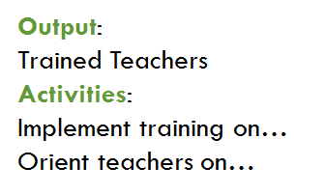
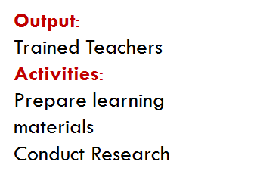
WFP Practice
Program
Output
Activity
Indicator
Program
Output
Activity
Indicator

Slide 40
WFP Practice
Program
Output
Activity
Indicator
Program
Output
Activity
Indicator

Slide 41
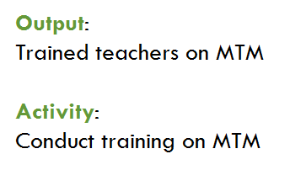
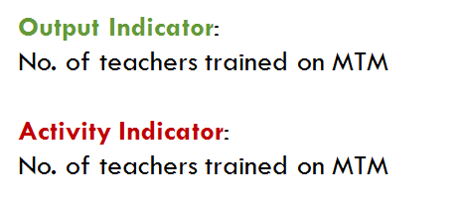
WFP Practice
Output
Activity
Indicator
Program
Output
Activity
Indicator
Program
Output
Activity
Indicator

Slide 42
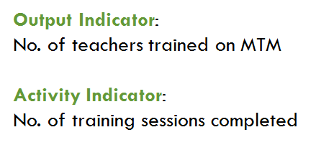
WFP Practice

Slide 43
Exercise 1
Output
A
Program | Output | Activity | Indicator
Reconciliation of Records on Tax and other Mandatory Benefits
 | Mid-Year 2020 Reconciled BIR Records |  | No. of Mid-Year 2020 BIR records reconciled
 |  | Conduct of Mid-Year Reconciliation Workshop of 2020 BIR Withholding Taxes | No. of Mid-Year Reconciliation Workshops of 2020 BIR Withholding Conducted

Slide 44
Exercise 2
OutActivity
Program
Output
Indicator
Program | Output | Activity | Indicator
EBEIS / LIS Data Management
 | Issues and concerns on EBEIS/LIS identified and resolved, and reports on resolutions submitted & monitored |  | No. of participants trained and consulted
 |  | Orient processes and guidelines on reports / validating and synchronizing the physical & financial accomplishments | No. of participants oriented

Slide 45
WFP Practice

Slide 46
PrograWFP Practice
Output
Activity
Indicator
Notes:
Dapat isa isa lang pra ma identify alin ANG na implement alin hindi

Slide 47
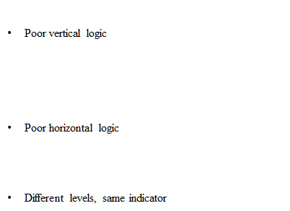
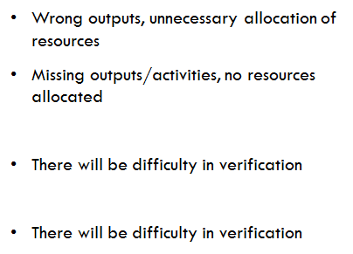
ProHow it affects WFP
Output
Activity
Indicator

Slide 48
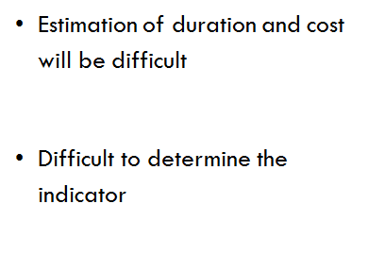
ProgHow it affects WFPm
Output
Activity
Indicator

Slide 49
P
Sample WFP
Activity
Indicator

Slide 50
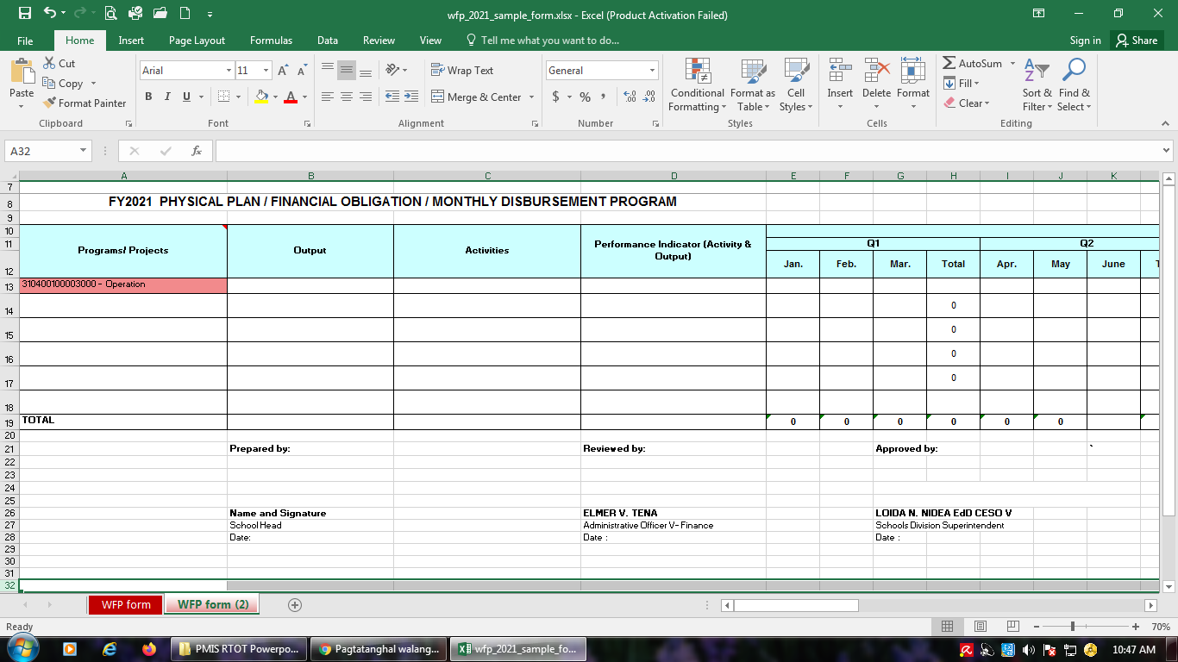
Output/Activity/Indicator

Slide 51
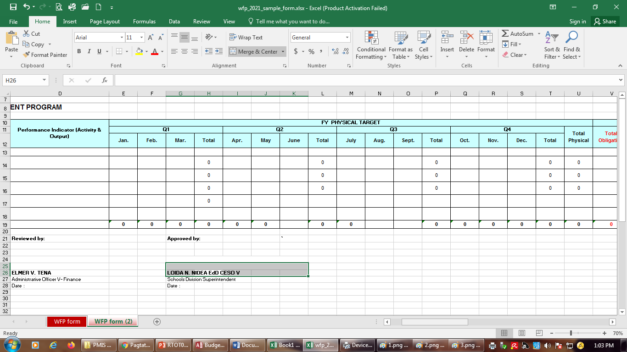
Schedule

Slide 52
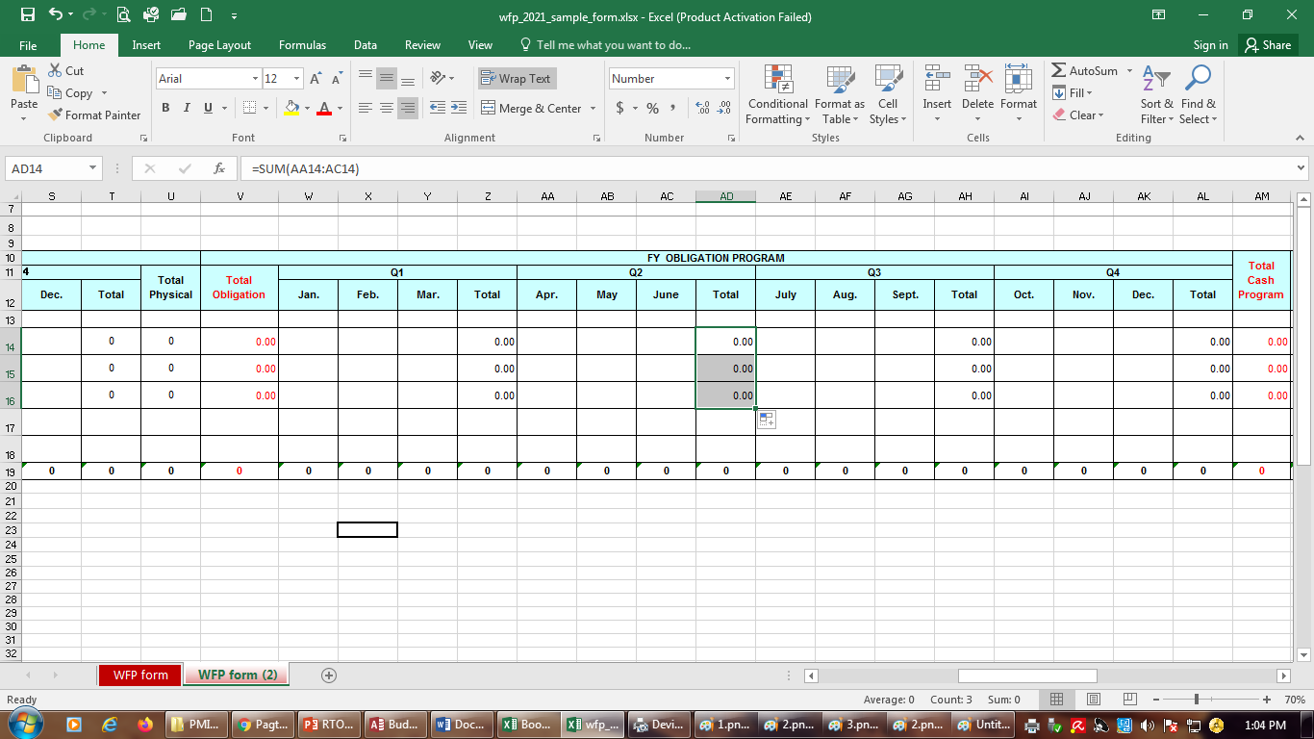
Cost
Notes:
mga common errors po natin total

Slide 53
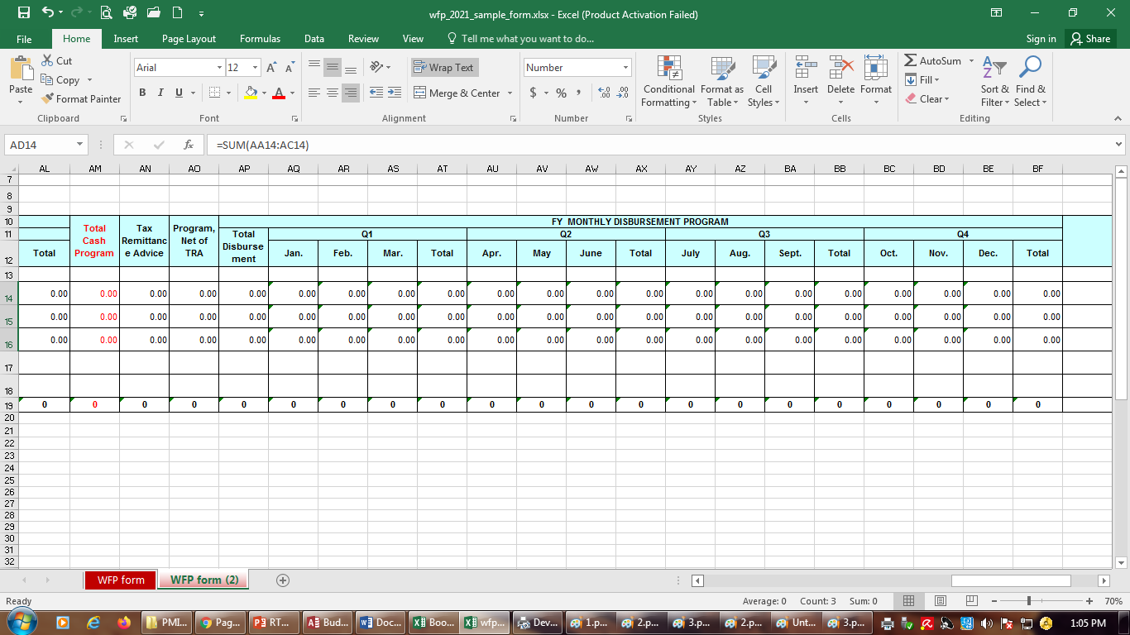
Cost

Slide 54
Sample WFP
•
wfp 2021 sample form.xlsx
Notes:
Remember: Hindi po ito paunahan sa pag submit.. Ang kailangan po namin is correct output. Please check the horizontal ang vertical total natin. Absolute Value po tayo.. Paki round off po sa nearest peso.. You don’t have to copy all those Activities na nsa sample.. Just choose what is applicable to your schools.. You can change po kong ano ang nasa sample. Lalo na po kong me specific activities na po kayo na naka plan (AIP or SIP)
Column V = column AM
Column AO = column AP
Make sure you drag the formula para makasama lahat ng amount sa total.

Slide 55
Checking the Financial Plan
•Should the obligations be equal to disbursements?
No, it should be equal to 95 % of total obligation
•Should obligations be scheduled at the same time as disbursements?
Yes for school cash advances
For direct payments it depends
•When do we obligate?
•When do we disburse?

Slide 56
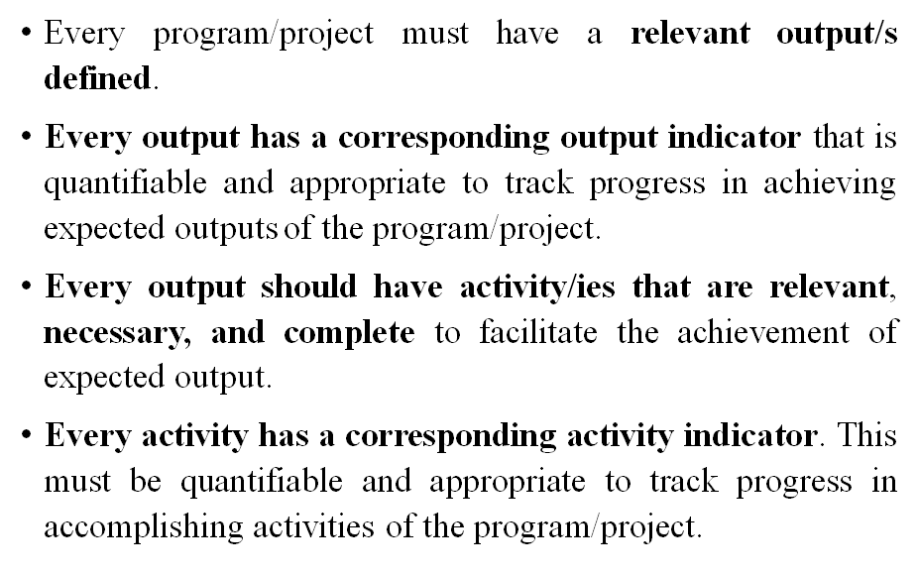
General Reminders
Activity
Indicator

Slide 57
General Reminders
Your NEP is equal to your WFP (check the total)Indicat
Don’t forget your School ID, Name of School, District, Name of School Head & Signature.
It should be in absolute value. Roud off to the nearest peso.

Slide 58
General Reminders
Submit in triplicate copies to your Liaison Officer. (with transmittal kapag dadalhin na sa Budget Office)
Check your total horizontally and vertically
Separate WFP for Junior HS & Senior HS
Notes:
kong pwede in a long side bond paper naka landscape.. wag na po yong tarpapel sobrong lapad nman tpos kakaunti lang naman.. you can delete those items na wala naman kyong nilagay na amount.. wag sobrang liit ng font na di na mabasa.. kya pa siguro hanga 10 ang font size.. at least blank ink.. paki tingnan ang total t baka po mga #### na lumalabas.. pagdugtungin nyo po ng paste.. submit nyo samin ng per district dalhin ng liason officer sa budget.. me transmittal po na naka attached..isang folder lang po or kong sobrang kapal 2 folders po..naka arrange po ha.. baka mga baliktaran mga pipirmahan ni sds..
Thats for Non Autonomous Schools.. sa mga OUs ang gagawin nyo po na WFP is for your own consumption po ...pra na po yan sa online encoding natin sa URS ng BEDs. When you prepare your WFP try to meet all your teachers kong ppwede pra mkapagplan kayong mabuti pra sa 2021 budget nyo.

Slide 59
General Reminders
Schedule of Submission for NON-OUsIndicator
1st Cong. District – October 12 and 19, 2020 only
2nd & 3rd Cong. District – October 13 & 20, 2020 only
4th Cong. District – October 14 & 21, 2020 only
5th Cong. District – October 15 & 22, 2020 only

Slide 60
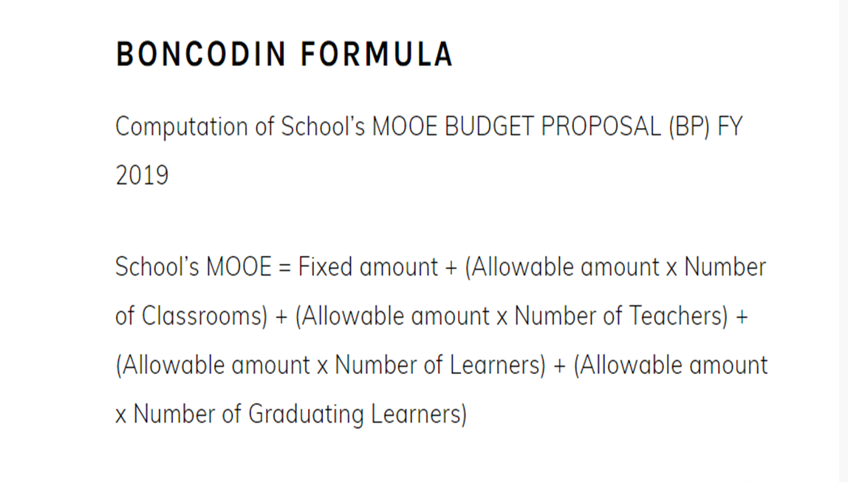
General Reminders
Activity
Indicator
Check your NEP

Slide 61
General Reminders
Activity
Indicator
Check your NEP

Slide 62
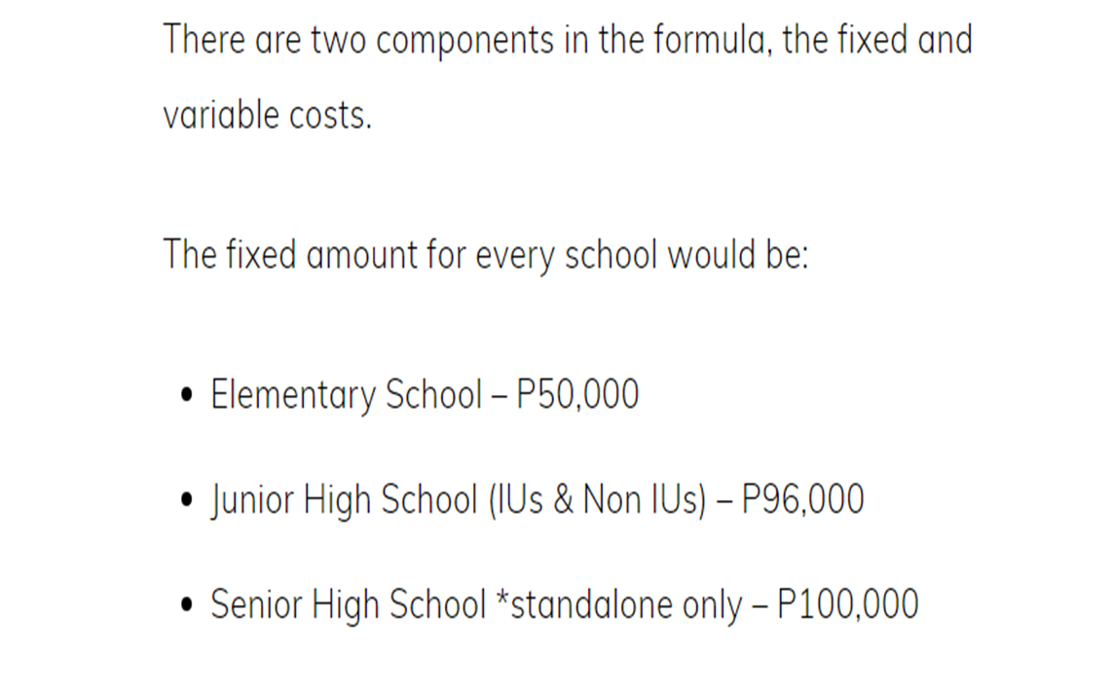
General Reminders
Activity
Indicator

Slide 63
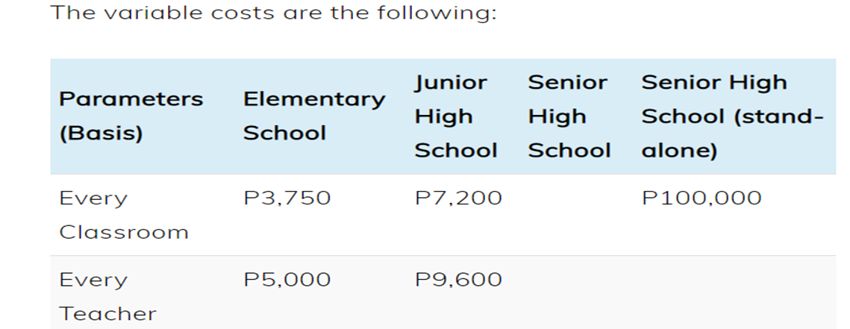
General Reminders
Activity
Indicator

Slide 64
Thank you!
Activity
Indicator
Notes:
Other reminders po.. We are on the last quarter and I know some of you will prepare already for your last downlad.. please.. please double check your balances baka wala na kayong balance or overdraft na ang school nyo ( its a big NO NO na maka incur kayo ng overdraft it is punishable by law) Another Thing po… yong mga me for reimbursement or nandoon sa scheme na reimbursement dahil sa some problems.. another please please.. agahan nyo ang pagsubmit.. make sure na nakaabot sa budget at naka pasok sa accounting.. pra masabi natin na me ORS or na obligate na. at mabayaran kyo.. laging nangyayari na kong kailangan tpos na ang taon at tpos na kmi s reports me makikiusap na tulungan sila.. at karamihan hindi na grant dhil bawal narin po kming mag revised ng reports. Sayang po ng pera ng dahil sa kunting pagkukulang sa pagmonitor or naging mabagal sa pag prepare ng docs di umabot sa deadline..na chacharge sainyo.

